Slide 1
Week 1
SOF 103
C and C++ Programming
Lecture 1
Introductory Class
Compile by Dr. Hew

Slide 2
Vision and Mission
Vision
Xiamen University Malaysia aspires to become a university with a distinct global outlook, featuring first-class teaching and research, and embracing cultural diversity.
Mission
To nurture young talents with dignity and wisdom, turning them into fine citizens of the region who will contribute to the prosperity of the people and social progress of Malaysia, China and Southeast Asia.
Compile by Dr. Hew

Slide 3
Instructor Brief
Assoc. Prof. Dr. Hew Soon Hin
PhD, Computer Assisted Language Learning
  Kyoto University, Kyoto, Japan
MSc(Honour) (Computer Science)
  National University of Malaysia, Bangi, Malaysia
BSc(Honour) (Mathematics)
  National University of Malaysia, Bangi, Malaysia
Soonhin.hew@xmu.edu.my
Compile by Dr. Hew

Slide 4
Introduce Yourself
Your name?
Email
Handphone number
Your hometown
Any previous experience in programming?
Expectation of this course?
Compile by Dr. Hew

Slide 5
Our Communication Mode
XMUM Moodle
  https://l.xmu.edu.my
email
  soonhin.hew@xmu.edu.my
Wechat (According to the lab session)
  Will be announced later
Compile by Dr. Hew

Slide 6
Slide Credits/ Additional Resources
The slides/diagrams in this course are mainly an adaptation, enhancement, and combination of the materials from the followings sources:
  Problem Solving with C++ (10th Edition), Walter Savitch, Addison Wesley, 2018
  Paul J. Dietel, C++ How to Program (10th Edition), Pearson, 2017.
  Object Oriented Programming in C++, Fourth Edition, Robert Lafore.
  Lecture notes from Dr. Kamran’s
  Software
  Codeblocks
  http://www.codeblocks.org/downloads/binaries/
Compile by Dr. Hew

Slide 7
Course Learning Outcomes
CLO No. | Description | Bloom’s Taxonomy Level | PLO
1 | Comprehend basic programming constructs of C and C++. | C2 | 1
2 | Demonstrate an understanding of the concepts and principles of C and C++ programming by solving real-world problems in particular. | C3 | 2
3 | Display a mastery of the C and C++ programming language. | P5 | 3
4 | Evaluate the given C/C++ code segments using algorithm tracing technique. | C4 | 7
Compile by Dr. Hew

Slide 8
Learning Style
This course is practical oriented
Exercises and Assignments will be beneficial for you
  (If done with academic honesty)
Memorization will not help you to get a good result
Copying Code:
  Strictly prohibited
  Zero tolerance
Compile by Dr. Hew

Slide 9
Tips to get a GOOD result
Attend every lecture and tutorial classes.
Do ALL Exercises during the lab sessions.
Submit ALL Assignments
3P - Practice, Practice, and Practice.
Compile by Dr. Hew

Slide 10
Chapter Overview
Things to Know Before Starting Learning to Program
Computer Systems
Programming & Problem solving
Introduction to C/C++
Testing & Debugging
Compile by Dr. Hew

Slide 11
Things to Know Before Starting Learning to Program
What is programming?
Why programming is important?
What skills are needed?
Points to remember!
Compile by Dr. Hew

Slide 12
What is Programming?
A computer program is…
  A set of instructions for a computer to follow
  Also known as software
  A structured combination of data and instructions used to operate a computer to produce a specific result.
Programmers use Programming languages to write codes line by line and construct computer programs.
Running a program means executing the instructions line by line and produce a expected result (Hopefully)
Compile by Dr. Hew

Slide 13
What is computer software?
Computer software is …
  The collection of programs used by a computer
    Includes:
        Editors
        Translators
        System software
        Application software, etc.
Compile by Dr. Hew

Slide 14
Why Programming is Important?
Why learn to program when a variety of application software and code generators are available?
  Important to learn for every computer scientist
  Develops analytical and problem solving abilities
  By designing programs, we learn many significant skills:
    Critical reading
    Analytical thinking
    Creative synthesis
Compile by Dr. Hew

Slide 15
What Skills are Needed?
Programming is an important activity as our lives depend on the programs we develop.
While programming, we should
  Pay attention to the details
  Think about reusability
  Think about user interface
  Understand the fact that computers are ‘stupid’
  Comment the code liberally
Compile by Dr. Hew

Slide 16
Points to remember!
Computers do what you instruct them
  Don’t assume anything on the part of the computer
Pay attention to the details
  Follow the principle of ‘how it works?’
Don’t forget to comment the code
User interface/interaction should be friendly
Program is not just writing a code but a whole process of design and development
Compile by Dr. Hew

Slide 17
Chapter Overview
Things to Know Before Starting Learning to Program
Computer Systems
Programming & Problem solving
Introduction to C/C++
Testing & Debugging
Compile by Dr. Hew

Slide 18
2. Computer Systems
Hardware
Software
High-Level Languages & Low-Level Languages
Compilers
Compile by Dr. Hew

Slide 19
Hardware
Three main classes of computers
  PCs (Personal Computer)
    Relatively small used by one person at a time
  Workstation
    Larger and more powerful than a PC
  Mainframe
    Still larger
    Requires support staff
    Shared by multiple users
Compile by Dr. Hew

Slide 20
Computer Organization
  Five main components
    Input devices
      Allows communication to the computer
    Output devices
      Allows communication to the user
    Processor (CPU)
    Main memory
      Memory locations containing the running program
    Secondary memory
      Permanent record of data often on a disk
Compile by Dr. Hew

Slide 21
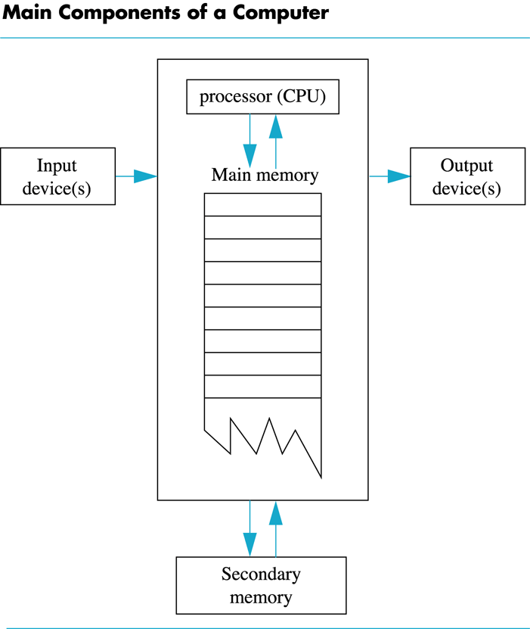
Computer Organization Cont…
Compile by Dr. Hew

Slide 22
Computer Memory
Main Memory
  Long list of memory locations
    Each contains zeros and ones
    Can change during program execution
  Binary digit or Bit
    A digit that can only be zero or one
  Byte
    Each memory location has eight bits
  Address
    Number that identifies a memory location
Compile by Dr. Hew

Slide 23
Computer Memory Cont…
Larger data items
  Some data is too large for a single byte
    Most integers and real numbers are too large
    Address refers to the first byte
    Next few consecutive bytes can store the additional
    bits for larger data
Compile by Dr. Hew

Slide 24
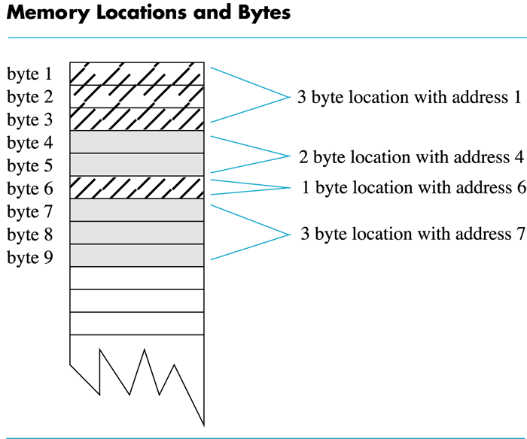
Computer Memory Cont…
Memory layout
Compile by Dr. Hew

Slide 25
Computer Memory Cont…
Data or code
  ‘A’ may look like 01000001
  65 may look like 01000001
  An instruction may look like 01000001
Compile by Dr. Hew

Slide 26
Computer Memory Cont…
Main Memory vs. Secondary Memory
Main memory stores instructions and
data while a program is running
Secondary memory
  Stores instructions and data between sessions
  A file stores data or instructions in secondary memory
Compile by Dr. Hew

Slide 27

Computer Memory Cont…
Memory access
  Random Access
    Usually called RAM
      Computer can directly access any memory location
  Sequential Access
    Data is generally found by searching through other items first
      More common in secondary memory
Compile by Dr. Hew

Slide 28
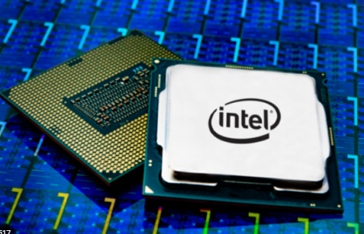
The Processor
Typically called the CPU
  Central Processing Unit
  Follows program instructions
  Typical capabilities of CPU include:
  add
  subtract
  multiply
  divide
  move data from location to location
Compile by Dr. Hew

Slide 29
Computer Software
The operating system
  Allows us to communicate with the computer
  Is a program
  Allocates the computer’s resources
  Responds to user requests to run other programs
Common operating systems include…
  UNIX, Linux, DOS
  Windows, Macintosh
Compile by Dr. Hew

Slide 30
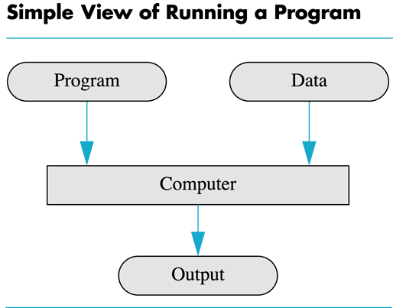
Computer Input
Computer input generally consists of two parts
  A program
  Some data
Compile by Dr. Hew

Slide 31
High Level Languages
Common programming languages include …
Python C# C C++ Java Pascal Visual Basic FORTRAN COBOL Lisp Scheme Ada
These high–level languages
  Resemble human languages
  Are designed to be easy to read and write
  Use more complicated instructions than the CPU can follow
  Must be translated to 0’s and 1’s for the CPU to execute a program
Compile by Dr. Hew

Slide 32
Low Level Languages
An assembly language command such as
ADD X Y Z
might mean add the values found at x and y
in memory, and store the result in location z
Assembly language must be translated to machine language (zeros and ones)
0110 1001 1010 1011
The CPU can follow machine language
Compile by Dr. Hew

Slide 33
Compilers
Translate high-level language to
machine language
  Source code
    the original program in a high level language
  Object code
    the translated version in machine language
Compile by Dr. Hew

Slide 34
Chapter Overview
Things to Know Before Starting Learning to Program
Computer Systems
Programming & Problem solving
Introduction to C/C++
Testing & Debugging
Compile by Dr. Hew

Slide 35
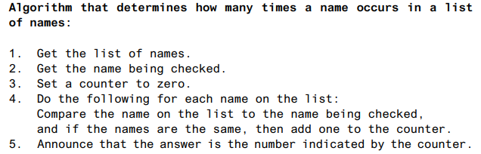
3. Programming and Problem Solving
Algorithm
  A sequence of precise instructions which leads to a solution
  Alternative terms: recipe, methods, directions, procedure, and routine
Program
  An algorithm expressed in a language the computer can understand
Compile by Dr. Hew

Slide 36
Program Design
Programming is a creative process
  No complete set of rules for creating a program
Program Design Process
  Problem Solving Phase
    Result is an algorithm that solves the problem
  Implementation Phase
    Result is the algorithm translated into a programming
    language
Compile by Dr. Hew

Slide 37
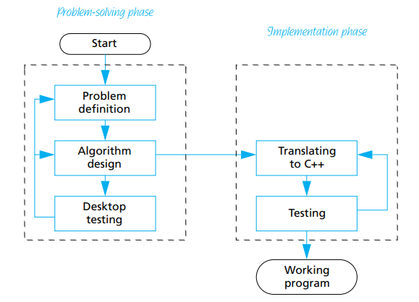
Program Design Cont…
Program design process
Compile by Dr. Hew

Slide 38
Problem Solving Phase
Be certain the task is completely specified
  What is the input?
  What information is in the output?
  How is the output organized?
Develop the algorithm before implementation
  Experience shows this saves time in getting your
  program to run.
  Test the algorithm for correctness
Compile by Dr. Hew

Slide 39
Implementation Phase
Translate the algorithm into a programming
language
  Easier as you gain experience with the language
Compile the source code
  Locates errors in using the programming language
Run the program on sample data
  Verify correctness of results
Results may require modification of
the algorithm and program
Compile by Dr. Hew

Slide 40
History of Programming
1st Generation Languages
Machine Language
2nd Generation Languages
Assembly Language
3rd Generation Languages
Procedural Programming Languages like Basic, Pascal, Fortran, C etc.
4th Generation Languages
OOP e.g. Java , C++, VB, Python, Matlab, C#, Perl, PHP, R etc.
5th Generation Languages
Constraint-based languages
Mainly used in artificial intelligence research
e.g., OPS5, Mercury
Compile by Dr. Hew

Slide 41
Chapter Overview
Things to Know Before Starting Learning to Program
Computer Systems
Programming & Problem solving
Introduction to C/C++
Testing & Debugging
Compile by Dr. Hew

Slide 42
Introduction to C/C++
Where did C++ come from?
  Derived from the C language
  C++ is an extension of the C language
  C++ is ( almost) a superset of C.
  Most C programs can be compiled by C++ compiler.
  We may say C++ is created by adding object-oriented functionalities to C.
Compile by Dr. Hew

Slide 43
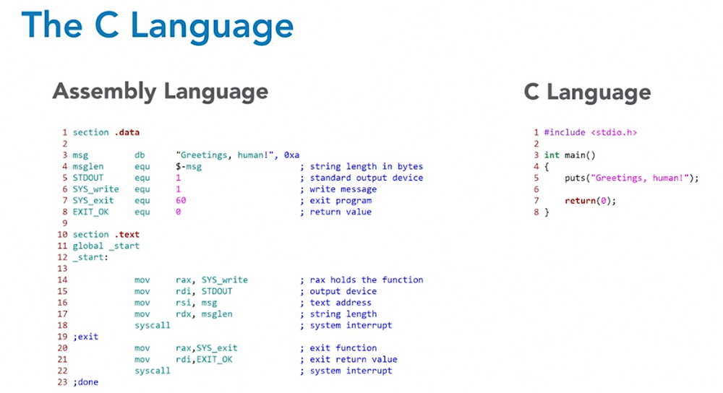
C vs Assembly language
Compile by Dr. Hew

Slide 44
C/C++ History
C was developed by Dennis Ritchie at AT&T
Bell Labs in the 1970s.
  Used to maintain UNIX systems
  Many commercial applications written in C
  C is a procedure programming language.
C++ developed by Bjarne Stroustrup at AT&T
Bell Labs starting from 1979.
  Overcame several shortcomings of C
  C++ is an object oriented programming language.
  C remains a subset of C++
Compile by Dr. Hew

Slide 45
Structure of C Program
# include <stdio.h>
int main ( )
{
printf(“Welcome to C” );
return 0;
}
Preprocessor Directives
Main Function
Function Body
Compile by Dr. Hew

Slide 46
Structure of C++ Program
# include < iostream>
int main ( )
{
std::cout << “Welcome to C++” ;
return 0;
}
Preprocessor Directives
Function Body
statement
Compile by Dr. Hew

Slide 47
Who should learn C++?
Who plan to become computer scientists
Who want to know all the ( system-level) details about a program.
Who want to learn other programming languages easily.
Compile by Dr. Hew

Slide 48
Preprocessor Directives
The first line of the program
# include < iostream>
is called a Preprocessor Directive,
The instruction that are given to the compiler before beginning of the actual program.
It begins with the # sign and a keyword (reserve word) “include” followed by
< name of header file>
Compile by Dr. Hew

Slide 49
Header Files
Header files are a part of the C / C++ Compiler and contain definitions of standard library functions.
Each header file may have an extension “.h”. The preprocessor “include” is used to add a header file into the source code. The name of the file is written in angle brackets “< >”, i.e.,
# include < name of header file>
For example;
iostream: The source file that contains declarations needed for input and output statements like cout/cin.
stdio.h : The source file that contains declarations needed for input and output statements like print/input.
Compile by Dr. Hew

Slide 50
The main( ) function
Functions are the fundamental building blocks of C++. The first program consists of a single function called main ( )
The main() function:
  The main function indicates the beginning of a C++ program.
  It must be included in every program. When a C++ program is executed, the control goes directly to main () function.
  The statements within this function are the main body of a program.
  If the main function is not included, the program is not compiled and an error is generated.
Compile by Dr. Hew

Slide 51
Syntax of main function
Syntax of the main() function is:
int main ()
{
body of main function
(program statements) ;
}
Compile by Dr. Hew

Slide 52
The Function Body
Braces: The braces ( Curly brackets “{ }“ ) indicate Begin and End of a function. Every function must use this pair of braces.
Program Statements: The basic unit of a C++ program. In our program we’ve only one program statement i.e.
cout << “Welcome to C++” ;
This statement tells the compiler to display the quoted phrase.
A semicolon (;) indicates the end of the statement.
Each statement has to be followed by a semicolon otherwise, a compilation error will occur.
Compile by Dr. Hew

Slide 53
OUTPUT USING cout
The identifier cout ( pronounced as “ C out” ) is a predefined object in C++, called as Standard Output Stream. It follows data to be displayed.
The operator << is called the Insertion or Put to operator.
In our example, the phrase “Welcome to C++” is an example of a String Constant or String Literal, is directed to cout by the insertion operator << and is to be displayed on the output.
Compile by Dr. Hew

Slide 54
The endl Manipulator
Manipulators are instructions to the output stream that modify the output in various ways.
This causes a linefeed to be inserted into the stream, so that the subsequent text is displayed on the next line. It has the same effect as the ‘\n’ character.
cout<<“1st Line text goes here”<<endl;
cout<<“2nd line text…"<<endl;
cout<<“3rd line goes here\n 4th line text\n”;
Compile by Dr. Hew

Slide 55
Comments
A comment statement is a non-executable statement. It is used to add remarks in a program. The compiler ignores the comments given in the program. Comments are used to explain, what a program is doing. Comments can be written anywhere in a program. Syntax:
// comments for single-line comments
/* comments…… for multi-line comments
……..*/
Compile by Dr. Hew

Slide 56
A program to demonstrate Escape Sequences & Comments
# include<iostream>
using namespace std;
int main() //beginning of main function
{
cout<<“\n \“XIAMEN \t UNIVERSITY\” ”; //printing outputs
cout<<“\n \’MALAYSIA\’ ”;
return 0;
}
Output ???
Compile by Dr. Hew

Slide 57
Escape Sequences
Escape sequences are written as a backslash character (\) followed by one or more control characters and are used to control the way output is displayed.
There are many escape sequences in C++. The newline escape sequence (\n) is just one of them.
Compile by Dr. Hew

Slide 58
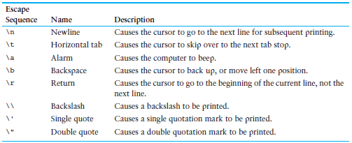
Common Escape Sequences
Compile by Dr. Hew

Slide 59
Chapter Overview
Things to Know Before Starting Learning to Program
Computer Systems
Programming & Problem solving
Introduction to C/C++
Testing & Debugging
Compile by Dr. Hew

Slide 60
5. Testing and Debugging
Bug
  A mistake in a program
Debugging
  Eliminating mistakes in programs
Can be done manually or using a debugger utility
Compile by Dr. Hew

Slide 61
Main Types of Errors
Syntax errors
  Violation of the grammar rules of the language
  Discovered by the compiler
    Error messages may not always show correct location of errors
Run-time errors
  Error conditions detected by the computer at run-time
Logic errors
  Errors in the program’s algorithm
  Most difficult to diagnose
  Computer/compiler does not recognize such errors
Compile by Dr. Hew

Slide 62
Syntax Errors vs Logic Errors
A syntax error occurs when the program does not follow the standard rule of the programming language. The compiler detects the syntax errors.
  cout << " The sum is << num1+num2;
  return 0
A logic error occurs when the program does not run as the programmer expect. The programmer must detect logic errors by himself. The process is called debugging.
Compile by Dr. Hew

Slide 63
Summary or Conclusion
Can you…
  Define what is a computer program?
  Describe the work of a compiler?
  Define source code and object code?
  Differentiate between high-level and low-level languages?
  Explain program design process?
  Explain this? #include<iostream>
  Explain ‘endl’?
  Explain escape sequences?
  State and differentiate between types of errors?
Compile by Dr. Hew

Slide 64
References
  Problem Solving with C++ (10th Edition), Walter Savitch, Addison Wesley, 2018
  CS201 Introduction to Programming, Virtual University of Pakistan
  Paul J. Dietel, C++ How to Program (10th Edition), Pearson, 2017.
  Object Oriented Programming in C++, Fourth Edition, Robert Lafore.
  Dr. Kamran’s notes.
Compile by Dr. Hew

